Slide 1
Aβ or not Aβ?… That is the Question!
Skylar Suarez & Larry Baker
BIOE 5100 Spring 2025

Slide 2
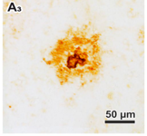
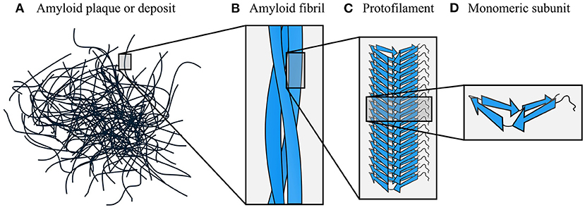
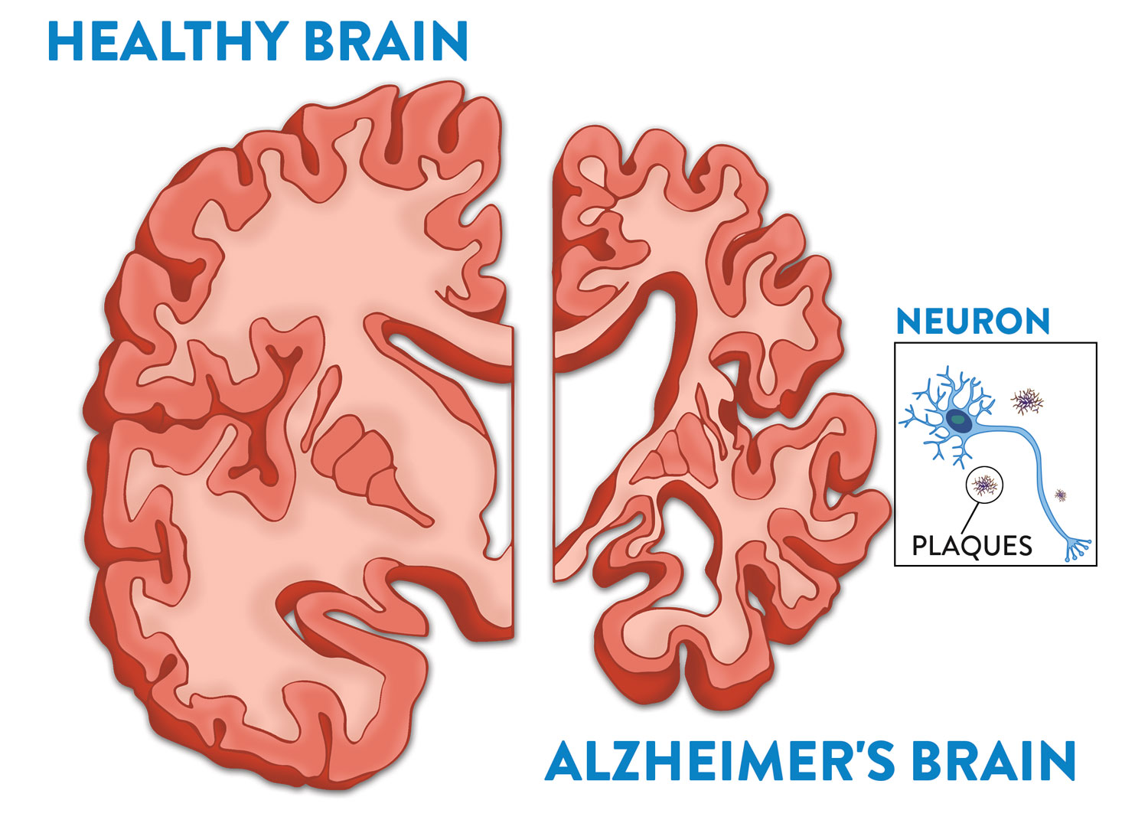
Amyloid-β (Aβ)
Monomeric Subunit Protofilament Amyloid Fibril Plaque
Rohr [2]
Taylor [1]
Big picture goal: to come up with a way to image these plaques without any stains or dyes.
So far, we have seen moderate success by exciting using light of near-UV wavelengths (300-450 nm).
Notes:
In AD, there is a protein called amyloid beta that misfolds, becomes sticky, aggregates together, and forms “plaques”.
The plaques deposit themselves in neural tissue and interfere with normal function, eventually leading to the dementia and memory loss characteristic of AD.

Slide 3
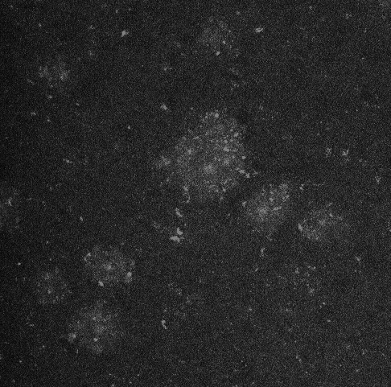
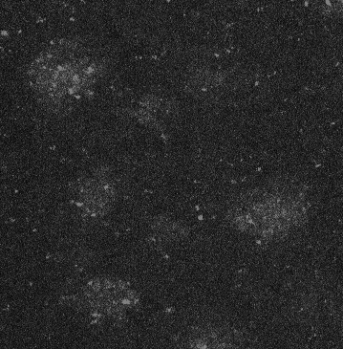
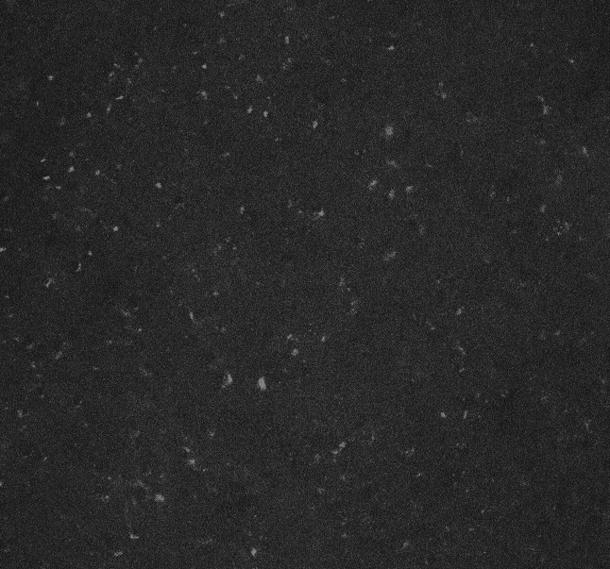
The Problem:
can we tell whether an image has Aβ plaques or not using computer vision?
5xFAD (AD mouse model) Hippocampus
C57 (control, no AD) Hippocampus
Confocal Microscope
λ_{ex} = 405 nm
λ_{em} = 425 – 475 nm
GOAL OF THIS PROJECT: classify the images between AD (has plaques) and NOT AD (no plaques)
Notes:
These images were taken on a confocal microscope using a DAP excitation and emission filter (ex 405 em 425-475). They are part of a proof-of-concept project I worked on last year.
These are slices of hippocampus brain tissue from 5xFAD transgenic mice – they get plaques starting at 5 months old.
The “blobs” you see are allegedly AB plaques. They may be hard to see at times, but they are there. I have a collection of ~40 of these images, all from various slices from 3 different mice.
THE GOAL: to classify the images between AD and not AD.

Slide 4
Roadblocks
Not all images are the same size.
Both AD and control images have speckling.
This comes from proteins we cannot avoid because they autofluoresce at our current λ_{ex} and λ_{em}

Slide 5
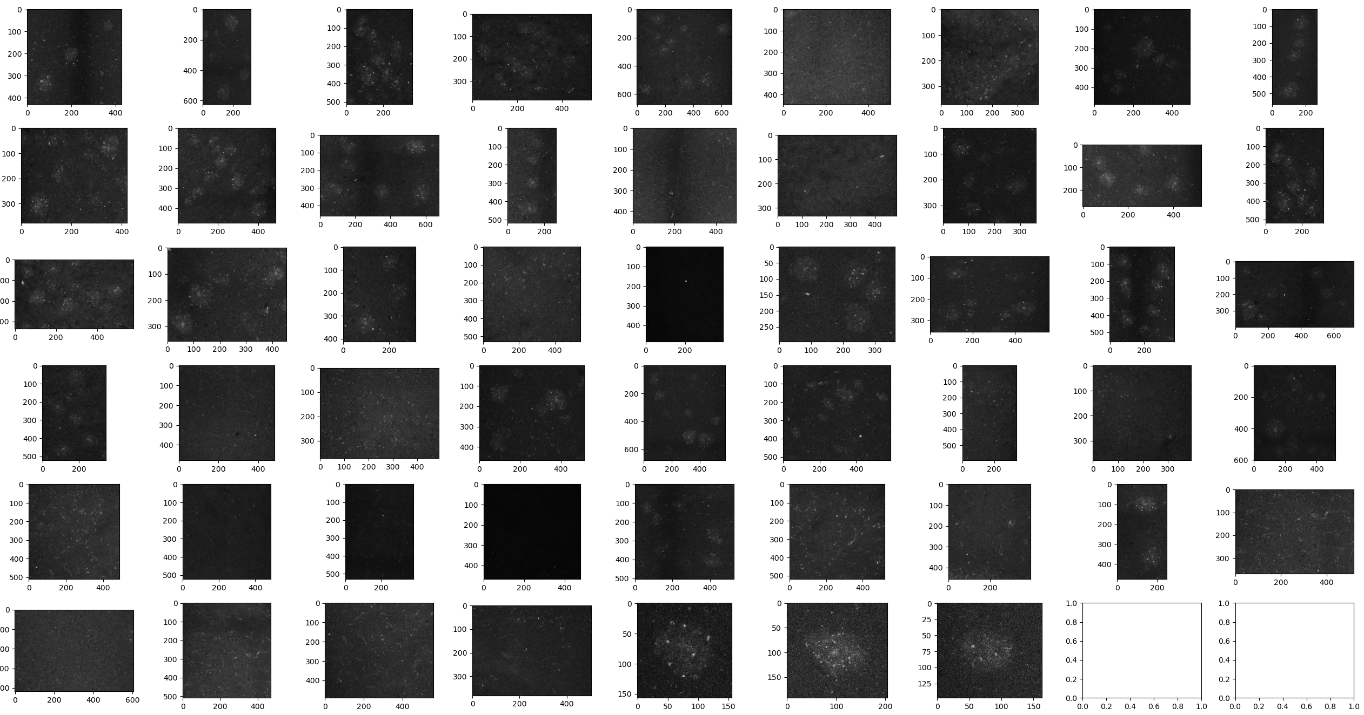
Addressing roadblock 1: Not all images are the same size
Upsizing
More computing time
No data is deleted, but…
Can introduce artificial data when that may not be true to the original content
Downsizing
Less computing time
Deleting pixels and intensities = losing important details/texture
No artificial data introduced
resize(min # of rows, min # cols)
Notes:
We upsized all images to the max #rows and #cols
Downsizing would have meant less computing time, but it would also mean deleting pixels/intensities, losing some info, and higher risk of overfitting

Slide 6
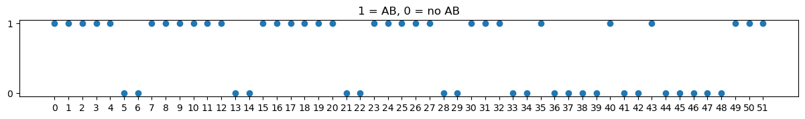

Slide 7
We are going to use two things: K means clustering (after gaussian filtering) and texture analysis
We will feed those two datasets to a logistic regression model for binary classification (will give us probabilities for each classification)
We will also try binary trees for classification
We do cross validation on both because our dataset is small
Cross validation splits the training data into pieces, uses one piece for validation and the rest for training. With this we can estimate how well the model will do with unseen data (our test data) while preventing overfitting.

Slide 8
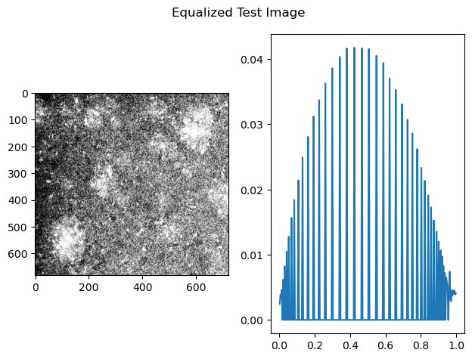
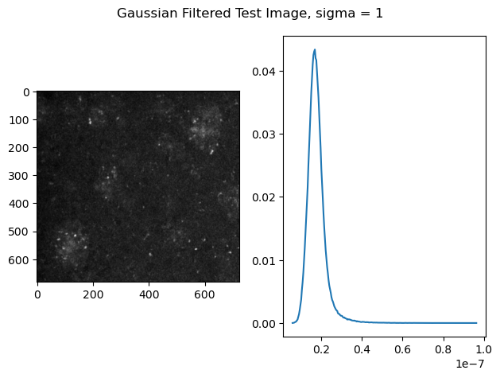
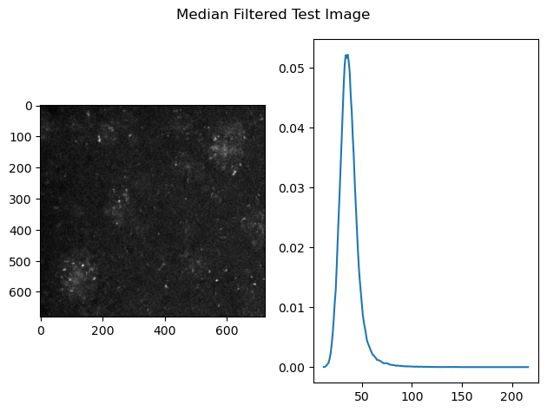
Notes:
Things we tried: equalizing, gaussian

Slide 9
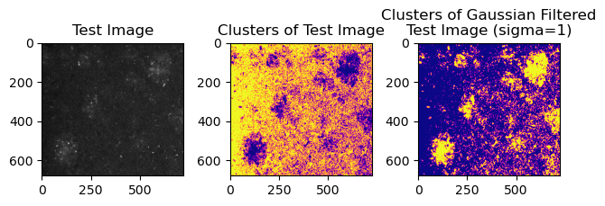
Notes:
Talk about k means clustering

Slide 10
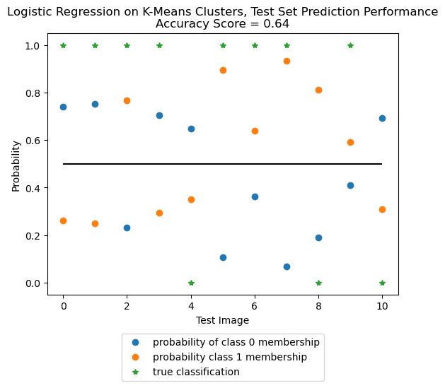
Logistic Regression Mean Squared Errors, CV of 5 folds =
[0.556 0.375 0.875 0.375 0.625]
Average CV error = 0.75
Notes:
These are the results of LR on the test set

Slide 11
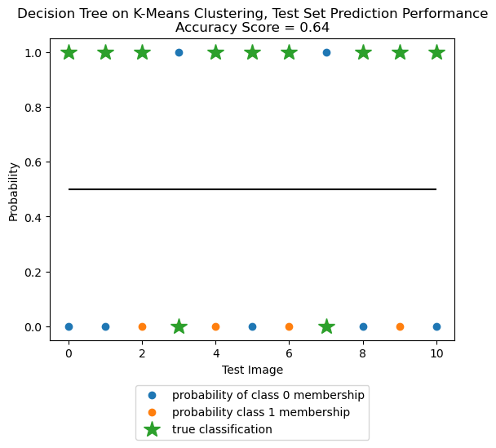
Decision Tree Mean Squared Errors, CV of 5 folds =
[0.444 0.375 0.625 0.375 0.375]
Average CV error = 0.66
Notes:
These are the results of LR on the test set

Slide 12
Notes:
Talk about GLCM

Slide 13
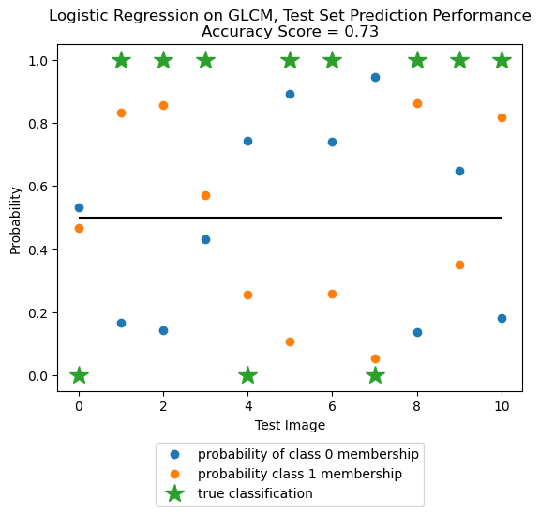
Logistic Regression Mean Squared Errors, CV of 5 folds =
[0.222 0.25 0.25 0.375 0.375]
Average CV error = 0.54
Notes:
These are the results of LR on the test set

Slide 14
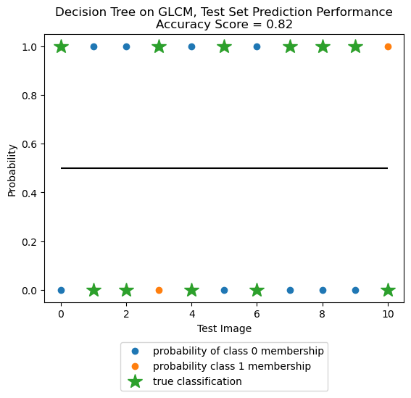
Decision Tree Mean Squared Errors, CV of 5 folds =
[0.556 0.25 0.375 0.25 0.375]
Average CV error = 0.6
Notes:
These are the results of LR on the test set

